Slide 1
Introduction to epa’s national-SCALE air toxics assessment (NATA) database
Presentation to the
Albuquerque-Bernalillo County Air Quality Control Board
By Kathryn E Kelly, DrPH
Delta Toxicology, Inc.
9 May 2018

Slide 2
OVERVIEW
Introduction to the EPA’s National-Scale Air Toxics Assessment (“NATA”) Database
What Is NATA?
What Kind of Data Are Presented?
Where Do the Data Come From?
How Can NATA Be Used?
How Should NATA Not Be Used?
Can We Use It to Examine Cumulative Impacts?

Slide 3
What Is NATA?
Started 1998 as the “Cumulative Exposure Project” with 32 Hazardous Air Pollutants (HAPs).
Today, an in-depth screening and prioritization tool that displays emissions, monitoring, and risk data on a map, including:
  Sources of 180 “air toxics” emissions
  Air toxics monitoring data for 2005 to 2013
  Modeled annual ambient concentrations
  Estimated cancer risks and respiratory hazard indices
  From national-scale down to census tracts

Slide 4
Why Did EPA Create NATA?
Identify
Identify those air toxics which are of greatest potential concern in terms of contribution to population risk.
Guide
Guide efforts to cut air pollution.
Build
Build upon the already significant emissions reductions achieved in the US since 1990.
Inform
Inform both national and localized efforts to collect air toxics information, characterize emissions, and help prioritize pollutants/geographic areas of interest for more refined data collection and analyses (e.g., CSATM).

Slide 5
How Can NATA Be Used?
EPA’s Goal: Identify national and regional air toxics of greatest public health concern
Prioritize pollutants and emission source categories
Identify locations of interest for further investigation
Provide a starting point for local-scale assessments
Focus and prioritize community efforts and resources
Inform monitoring programs

Slide 6
Can NATA Be Used to Assess Cumulative Risks?
Yes. “The national-scale assessment described in this document is consistent with EPA’s definition of a cumulative risk assessment, as stated in EPA’s Framework for Cumulative Risk Assessment as “an analysis, characterization, and possible quantification of the combined risks to health or the environment from multiple agents or stressors.” The conceptual model defines the actual or predicted relationships among exposed individuals, populations, or ecosystems and the chemicals or stressors to which they might be exposed.” NATA Technical Support Document, 2015

Slide 7
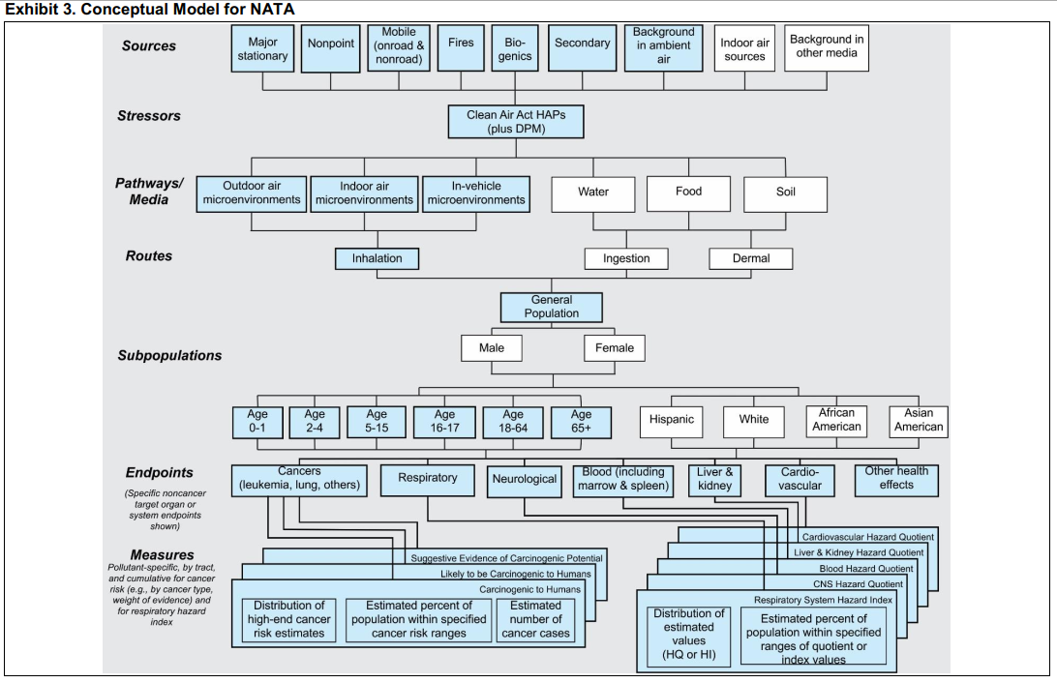

Slide 8
Cumulative Risk vs. Cumulative Impacts
1. What are the cumulative health risks from local air pollution?
Which cumulative risks exceed health or regulatory thresholds?
    ***If no thresholds are exceeded, there are no impacts to evaluate.***
    _____________________________________________________________
What are the cumulative impacts of exceeded thresholds?
What can be done to reduce impacts to below thresholds?

Slide 9
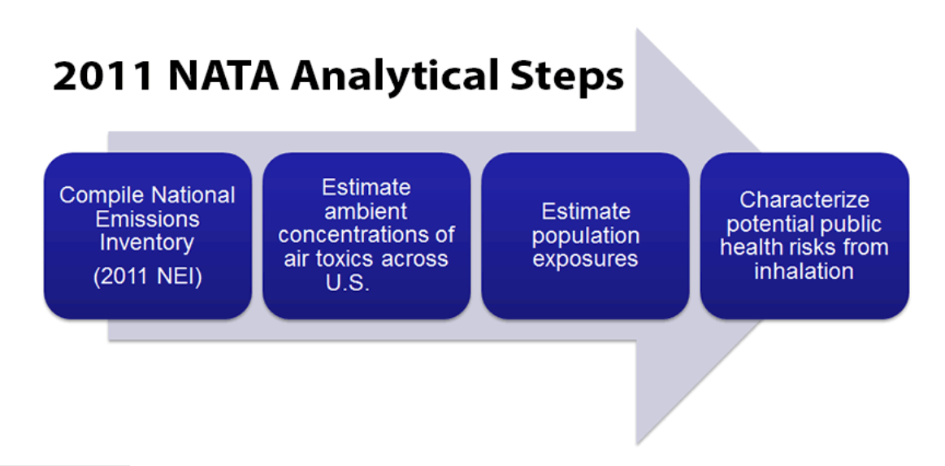
Four NATA Steps
a

Slide 10
Compile Emissions Sources
Small, multiple “non-point” (woodstoves, home heating, restaurants, gas stations, emergency generators, boilers)
Mobile (on- and off-road: trains, planes, automobiles, buses, trucks, lawnmowers)
Biogenic sources
(plants, trees, soil)
Fires
(wild, prescribed, agricultural)
Secondary formation (atmospheric transformation)
Background concentrations (naturally occurring or long-lasting)
Large, permitted industry & gov’t “point” sources

Slide 11
Estimate Ambient Concentrations
E.g., Benzene Exposure Concentration
in Bernalillo County (2011, EPA NATA)

Slide 12
Estimate Population Risks from Outdoor Emissions Sources
Cumulative Cancer Risk
Cumulative Respiratory Hazard

Slide 13
NATA Conclusions
The average, national cancer risk from air toxics is 40 in 1 million.
~1 in every 25,000 people have an increased likelihood of contracting cancer as a result of breathing air toxics from outdoor sources if they were exposed to 2011 emission levels over the course of their 70-year lifetime.

Slide 14
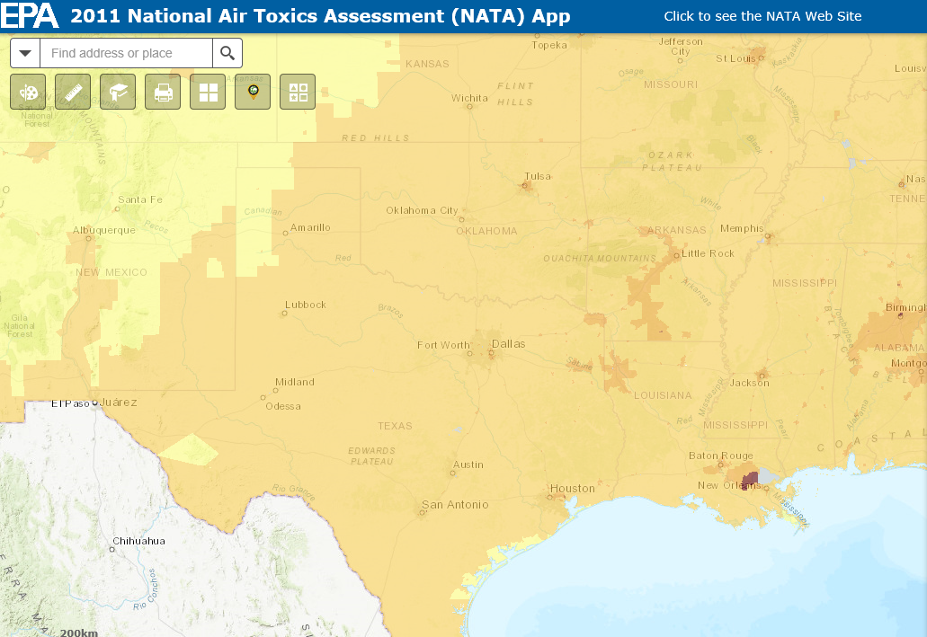
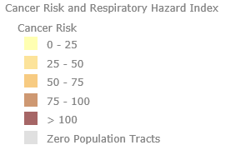
Air Toxics Cancer Risks - Southwest

Slide 15
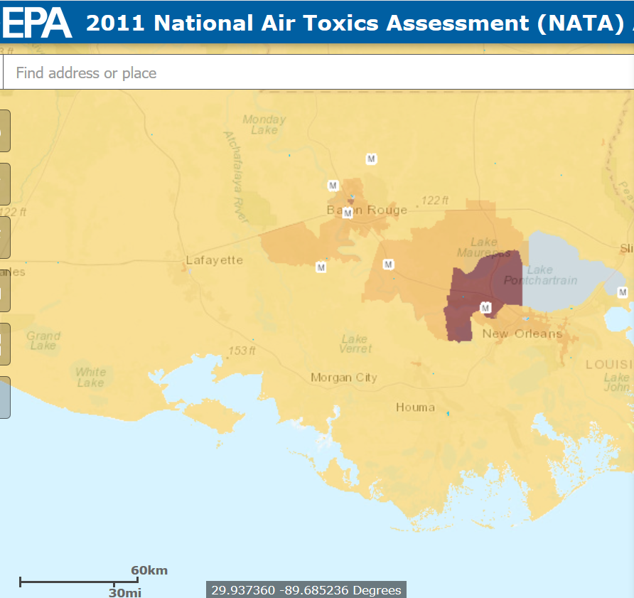
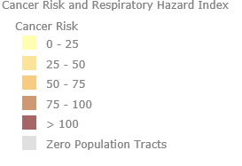
Air Toxics Cancer Risks:
Louisiana
Source: https://gispub.epa.gov/NATA/

Slide 16
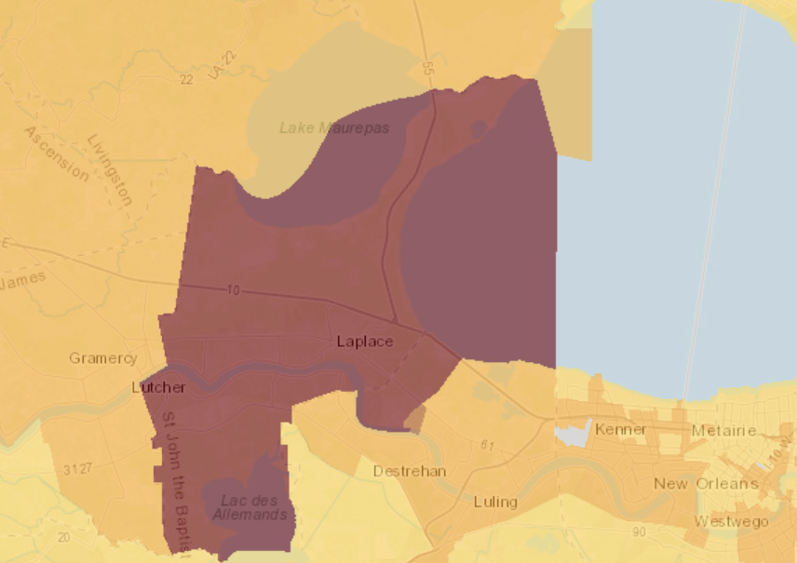

Slide 17
NATA Conclusions
National cancer risk driver: Formaldehyde
Regional cancer risk drivers: Benzene, Chloroprene, Coke Oven Emissions
_____
National noncancer hazard drivers: Acrolein (70%), Chlorine, Diesel PM.
Regional noncancer hazard drivers: Hexamethylene Diisocyanate

Slide 18
The Fine Print: Limitations of NATA
Don’t compare results with past NATA databases; the methodology is continuously refined.
The overall quality and uncertainties of the assessment will vary from location to location and from pollutant to pollutant. In many cases more localized assessments, including monitoring and modeling, may be needed to better characterize local-level risk.
Gaps in data
Limitations in computer models
Default assumptions used routinely in any risk assessment
Limitations in the overall design of the assessment (intended to address some questions but not others).
Variations in detail and completeness of inventories from different geographical regions
Results apply to geographic areas, not specific locations.
Results do not include impacts from sources in neighboring countries (i.e., Canada or Mexico).
Results apply to groups, not to specific individuals.
Results are restricted to the year of the analysis since emissions for that year were used.
Results do not reflect exposures and risk from all compounds.
Results do not reflect all pathways of exposure.
Results reflect only compounds released into the outdoor air.
Results do not fully reflect variation in background ambient air concentrations.
Results might systematically underestimate ambient air concentration for some compounds.
Results used default, or simplifying, assumptions where data were missing or of poor quality.
Results may not accurately capture sources that have episodic emissions (e.g., prescribed burning or facilities with short-term deviations such as startups, shutdowns, malfunctions, and upsets).
Estimates of risk are uncertain.

Slide 19
NATA assessments should not be used for the following:
as a definitive means to pinpoint specific risk values within a census tract
to characterize or compare risks at local levels, such as between neighborhoods
to characterize or compare risks between states
to examine trends from one NATA year to another
as the sole basis for developing risk reduction plans or regulations
as the sole basis to control specific sources or pollutants, or
as the sole basis to quantify benefits of reduced air toxic emissions

Slide 20
Next Steps?
What does the Air Board want to know more about?
Conduct detailed NATA analysis of census tracts, emissions sources, and/or specific air toxics and health risk estimates for Bernalillo County?
Review EHD Community-Scale Air Toxics Monitoring and Risk Assessment Project?
Understand county emissions data?
Learn EPA’s process for conducting a Cumulative Risk Assessment?
Prepare additional analysis comparing air pollution to other health risk factors?

